Slide 1
Industrial Pharmacy II
By
Dr. Mohammed Sabbar
4th Oct. 2018
http://bit.do/ex2a6

Slide 2
Emulsions dosage forms
Two immiscible liquid dosage form
Internal (droplet dispersed <74%) in external (continuous phase)
O/W & W/O [ W/O/W & O/W/O (multiple -1978)]
Appearance
Emulsifier:
Molecule acts as wetting or surfactant and has lipophilic and hydrophilic portions
Heating may required to melt oil to sure in liquid state
Notes:
W/O/W = O/W & O/W/O=W/O

Slide 3
Radius of droplet : 0.25-10microns opaque in color
Less than 120nm appear as transparence
(less than 25% of visible light wave length)
Micro-emulsion or Micellar emulsion
10-75nm are possible to prepare
For IV has to be less than 100nm

Slide 4
Applications
Topical: W/O for dry skin penetration needs thixotropic (general believe) O/W
Orally : to enhance palatability and absorption of readily absorbable drugs and un-absorbable macromolecules like insulin and heparin
I V

Slide 5
Droplet Stabilization
1. Reduction of interfacial tension thermodynamic stabilization.
2. Formation of a rigid interfacial film mechanical barrier to coalescence.
3. Formation of an electrical double layer electrical barrier to approach of particles.
By interfacial barrier
By monomolecular film
Amphiphilic
Action of emulsifying agent

Slide 6
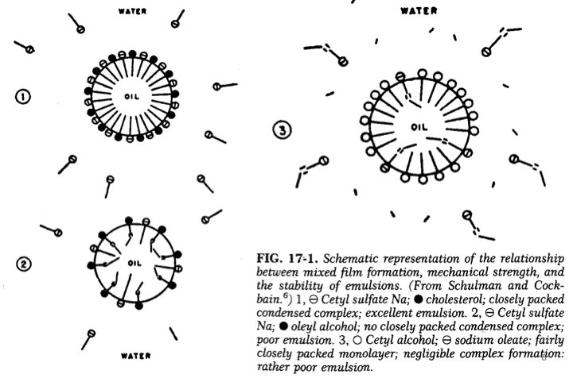

Slide 7
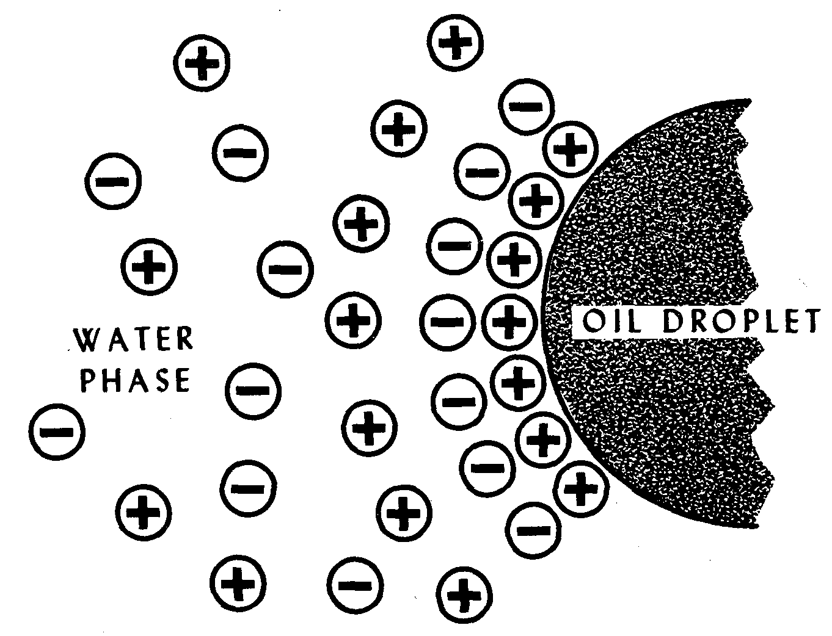

Slide 8
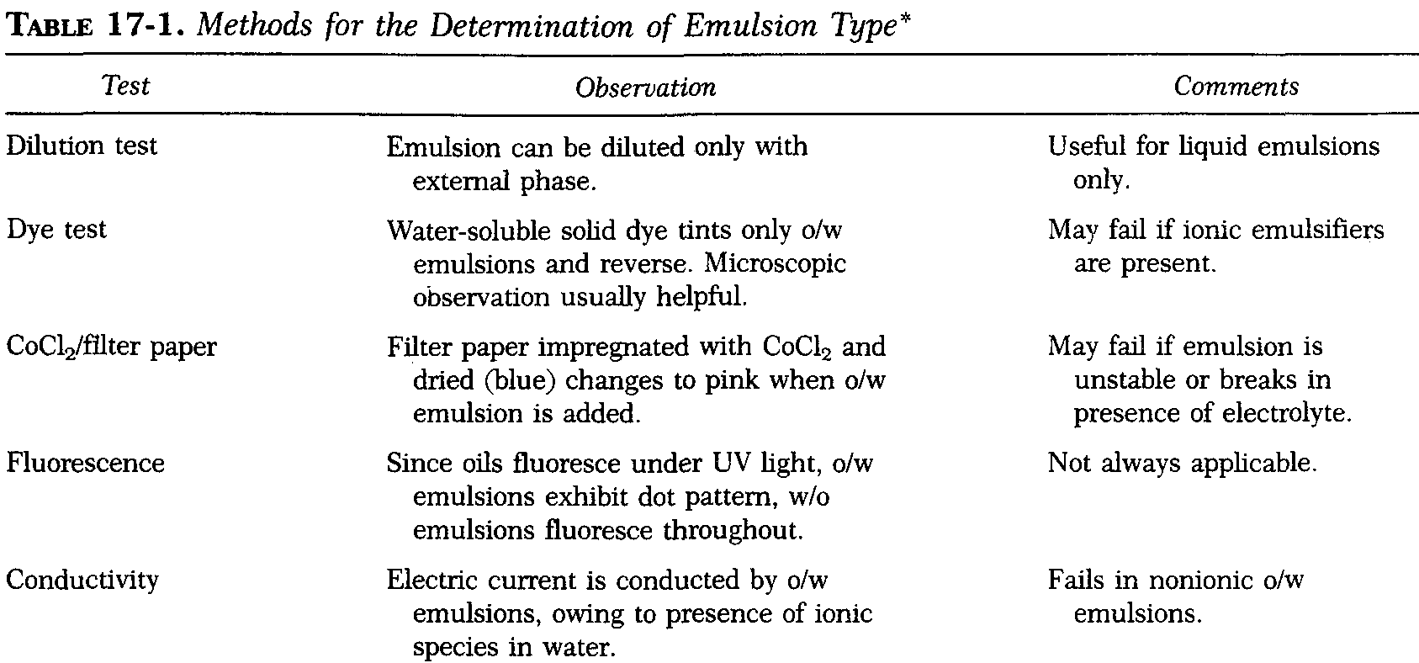

Slide 9
Sequence of processes
By mean of stirrer
Rate of coalescence is time and temperature dependent

Slide 10
: condensation method for dilute emulsion
PIT
Preparation with heating get o/w and on cooling get w/o

Slide 11
Timing
best way of forming an emulsion
by use intermittent shaking.
That could emulsify 60% by volume of benzene in 1% aqueous sodium oleate by mechanically shaking 750 times during a period of four to five minutes.
The same mixture, however, could be completely emulsified with merely five hand shakes in about two minutes, if the emulsion was allowed to rest for 20 to 30 seconds after each shake.
The reasons for the observed time dependent droplet stabilization may be distribution of the emulsifier between the phases, slow formation of the (double-layer) film on the surface of the benzene droplets, or interruption of droplet formation by continuous shaking.

Slide 12
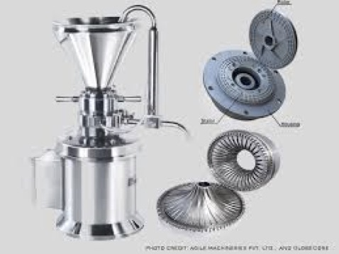
Mechanical Equipment for
Emulsification
Mechanical Stirrers
Homogenizers
Ultrasonifiers
Colloidal mills.

Slide 13
In microemulsion
Because SAA (emulsifier) Can be avoided by using container with minimum air space

Slide 14
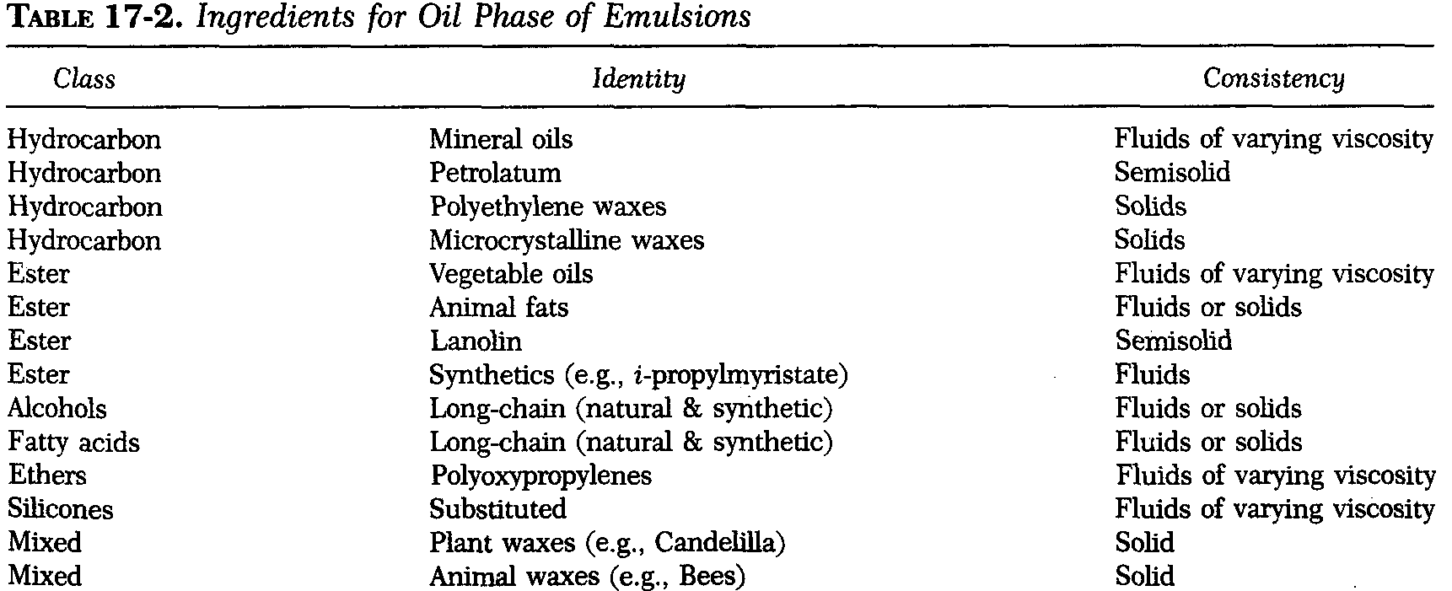

Slide 15
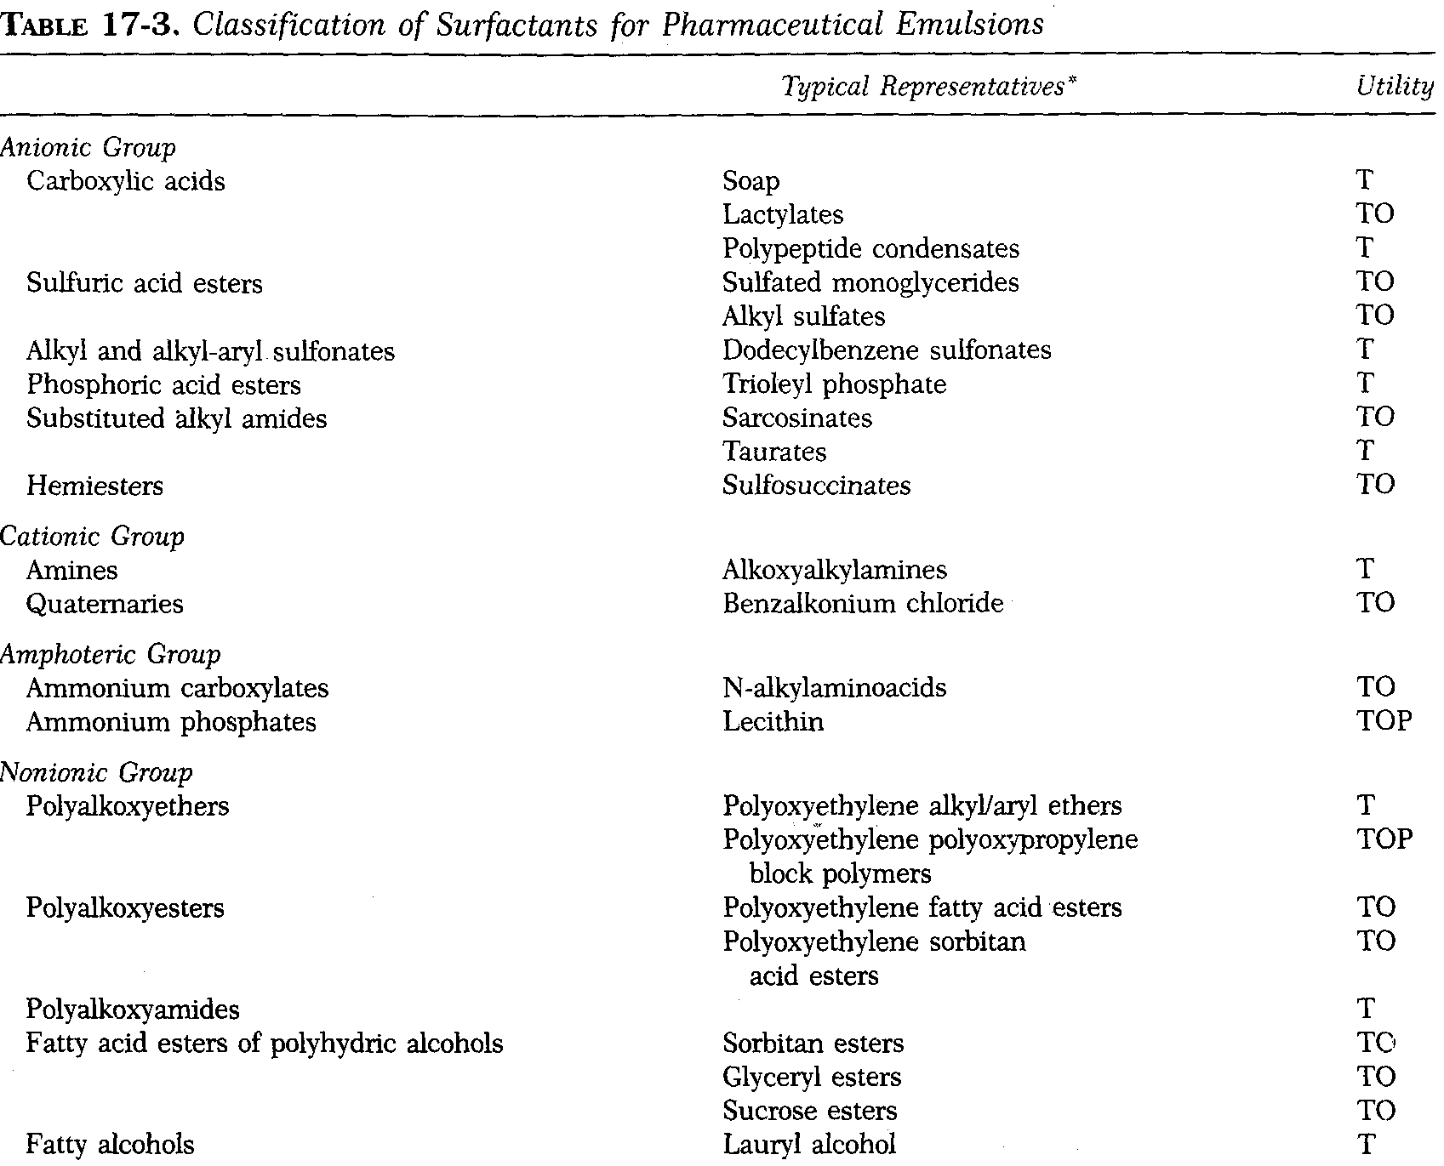
Notes:
T = some representatives useful in topicals.
O = some representatives useful in oral preparations or ingested drugs.
P = some representatives useful in parenterals.

Slide 16
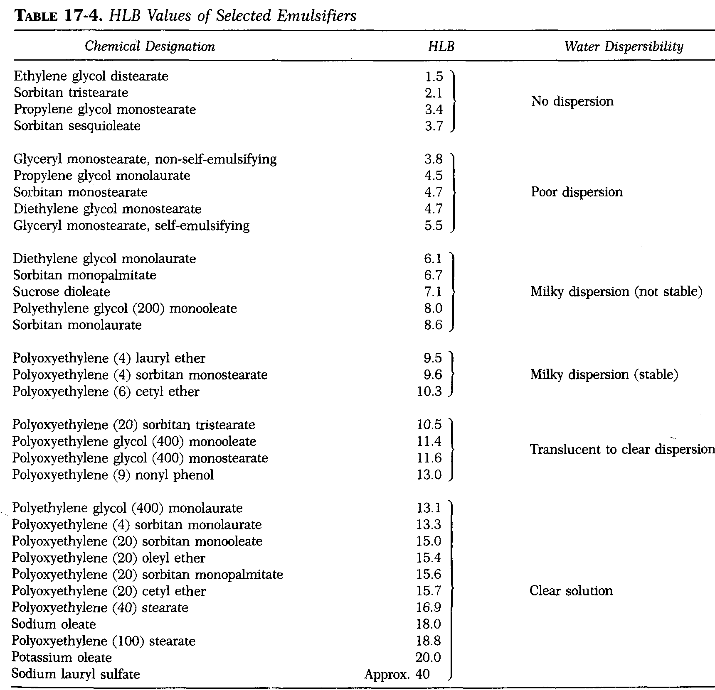

Slide 17
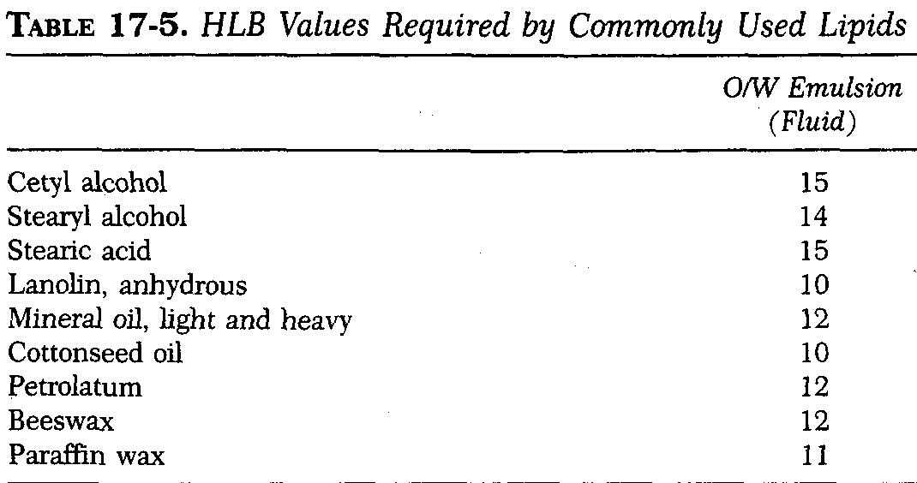
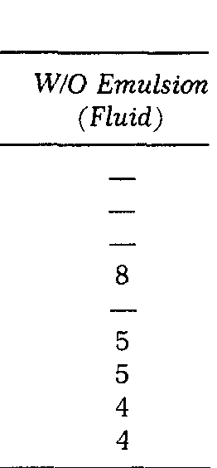

Slide 19
Tables
17-7
17-8
17-9
17-10

Slide 20
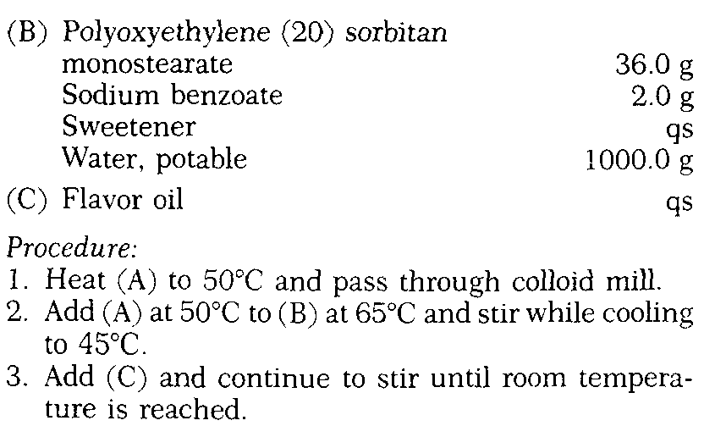

Slide 21
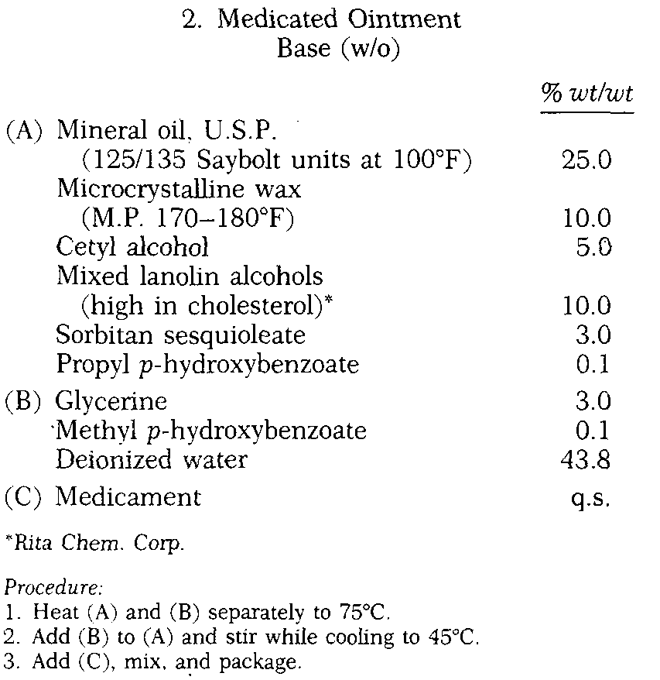

Slide 22
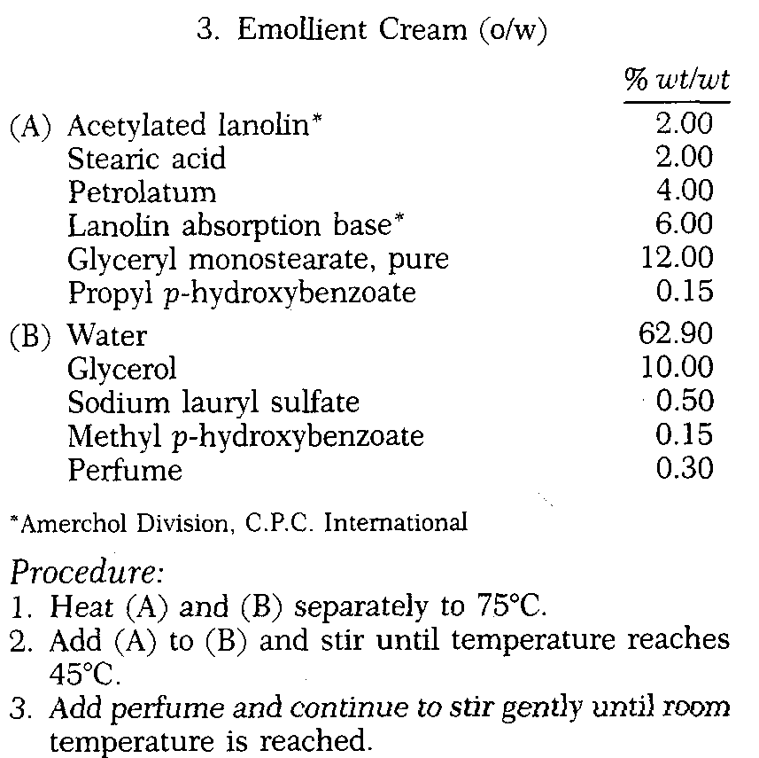

Slide 23
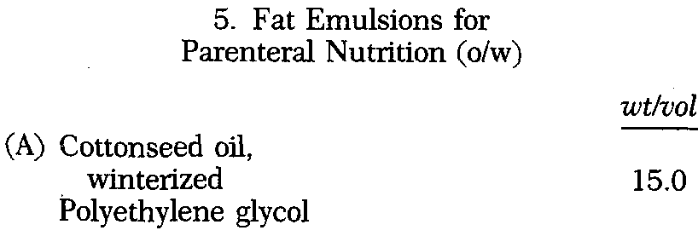
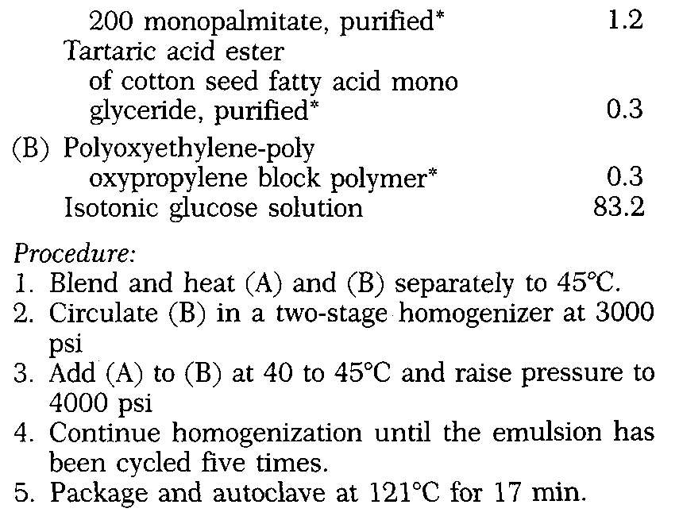

Slide 24
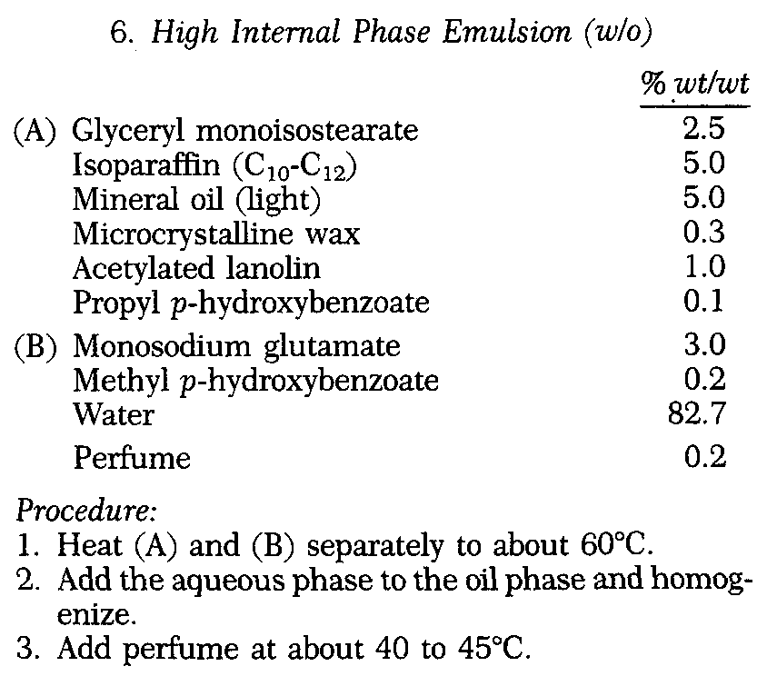

Slide 25
Interfacial energy
Phase separation of cream up or cream down (rises or sediments)
Reversibility of phases with cycle change in the temperature
Kinetic stability and shelf life
Mathematical model

Slide 26
Depend on stock’s law
May before, during or after creaming
Merge of droplet into larger
Can be in flocculated and unflocculated emulsion
Because of weakness in interfacial barrier of ??
Nonionic sufactant

Slide 27
Assessment of emulsion shelf life
Arrhenius
Each 10 degree increase in temp. cause double in rate of hydrolysis
3750 rpm in 10cm radius centrifuge for 5hr period equal 1year

Slide 29
Typical test for acceptable emulsion
1- No visible signs of separation for
A-60-90 days at 45-50C and
B-5-6months at 37C and
C-12-18months at room temp. and
D- 1month at 4C
4-During the testing period just described, the samples stored at various conditions should be observed critically for separation, and in addition, monitored at reasonable time intervals forthe following characteristics:
Change in electrical conductivity
Change in light reflection
Change in viscosity
Change in particle size
Change in chemical composition
2-Survive after 6-8 cycle heating-cooling 4-45C with 24-48hr stay at each temp.
3-Survive after agitation in reciprocating shaker 60cycleper minute at room temp. and 45C..

